Slide 1
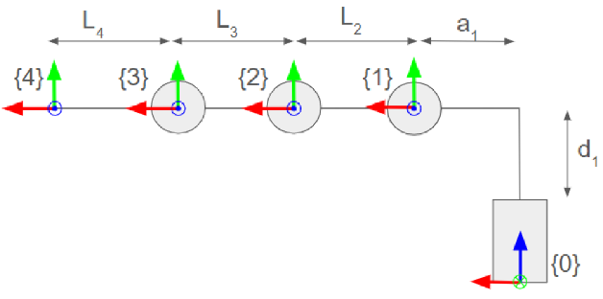
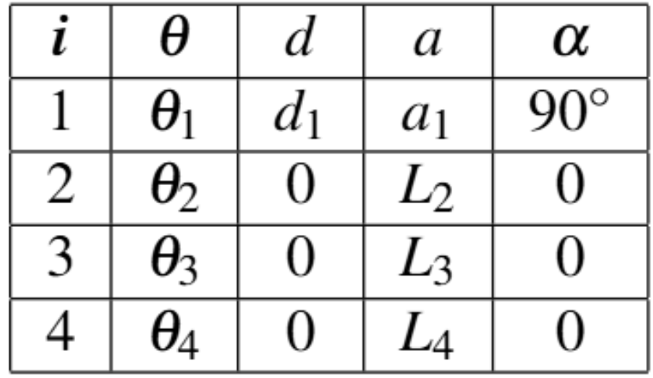
Forward Kinematics of GRASPI
DH Table
Diagram of Kinematic Structure

Slide 2
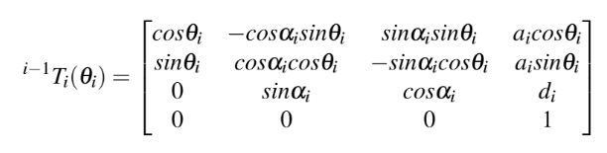
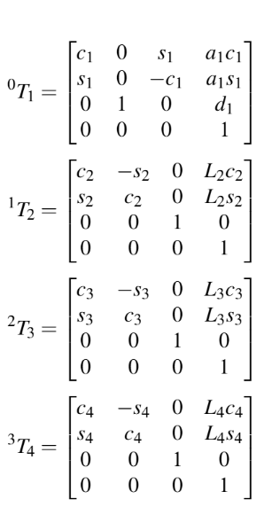
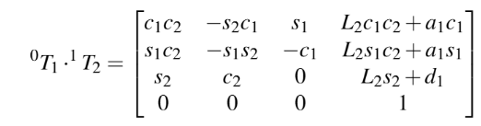
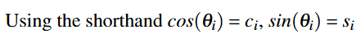
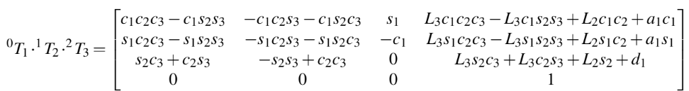
Forward Kinematics of GRASPI
Using the general formula for the transformation matrix between each link frame:
(1)

Slide 3
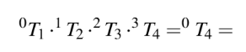
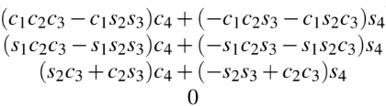
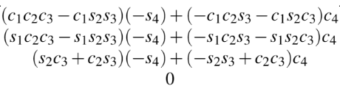
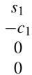
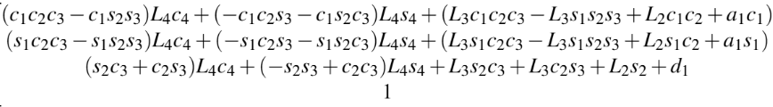
Forward Kinematics of GRASPI
Column 1:
Column 2:
Column 3:
Column 4:

Slide 4
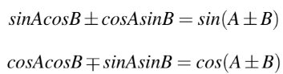
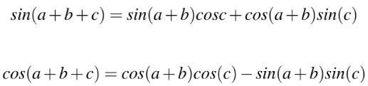
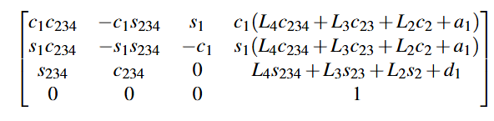
Forward Kinematics of GRASPI
Trigonometric identities
Simplified:

Slide 5
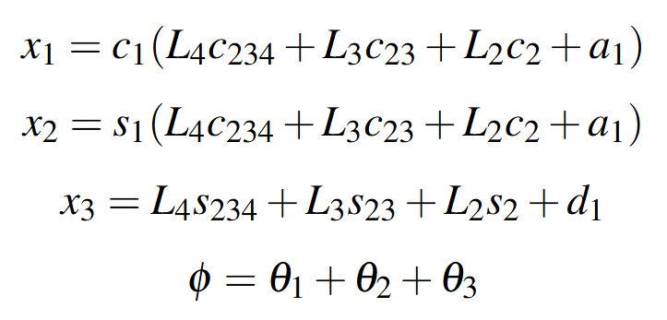
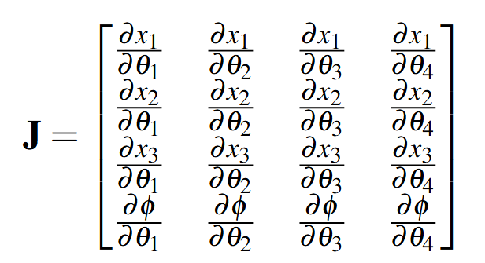
Dynamics of GRASPI
Using the fourth column of the forward kinematics matrix, the position and orientation of the end effector of one finger, X = [x₁, x₂, x₃, φ]^{T} is given by:
Then using the Jacobian definition:

Slide 6
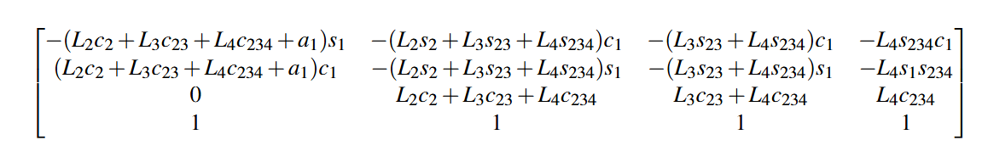
Dynamics of GRASPI
The Jacobian was found to be:
J =

Slide 7
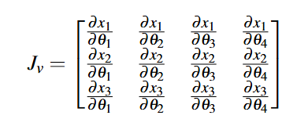
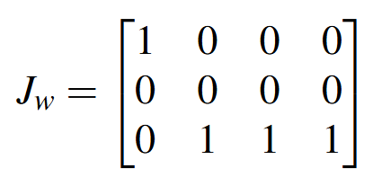
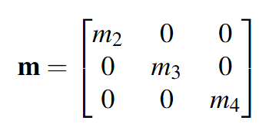
Dynamics of GRASPI
Separating the Jacobian into linear and angular components:
And constructing a mass matrix with the masses that are moving (m₂, m₃, m₄)

Slide 8
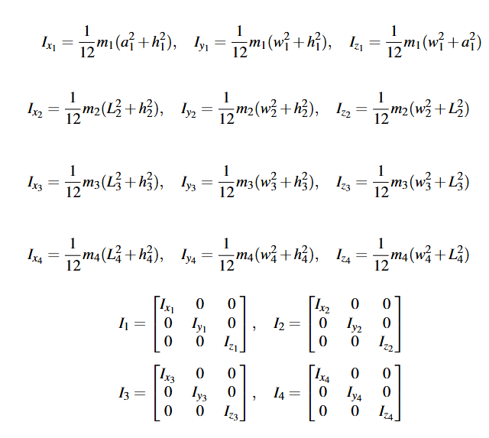
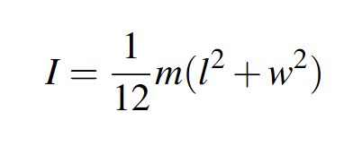
Dynamics of GRASPI
Then using the formula for the moment of inertia for a cuboid as a rough approximation
The inertia tensors for each link can be found:

Slide 9
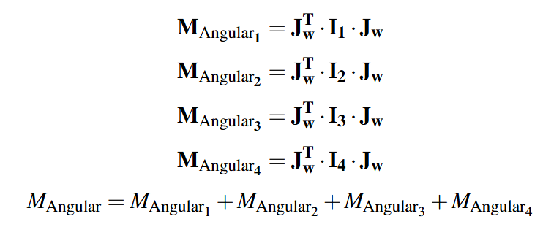
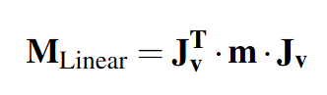
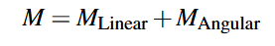
Dynamics of GRASPI

Slide 10
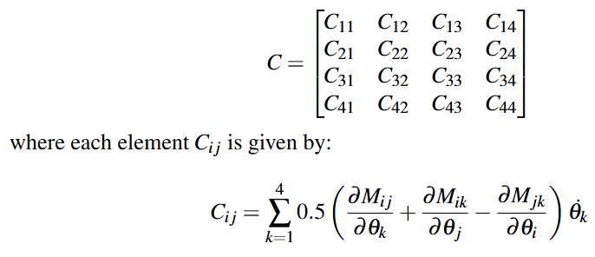
Dynamics of GRASPI
Then finding the Coriolis Matrix using Christoffel Symbols:

Slide 11
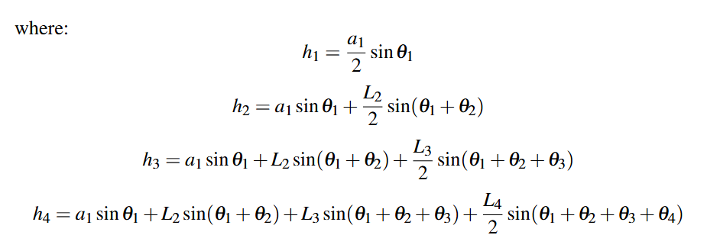
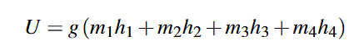
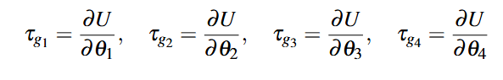
Dynamics of GRASPI
Using an approximation of the heights of the centre of mass of each link, the gravitational torque vector was found by first calculating the potential energy:
And then finding the partial derivatives for these with respect to each value of θ to find the components of the gravitational torque vector, τ_{g}:

Slide 12
